Slide 1
Modeling Ultracompact Black Hole White Dwarf Binaries in Dense Stellar Clusters
Yi Wei (William) Yang
Mentor: Kyle Kremer
24th July 2024
Credit: ESA/Hubble & NASA, F. Ferraro

Slide 2
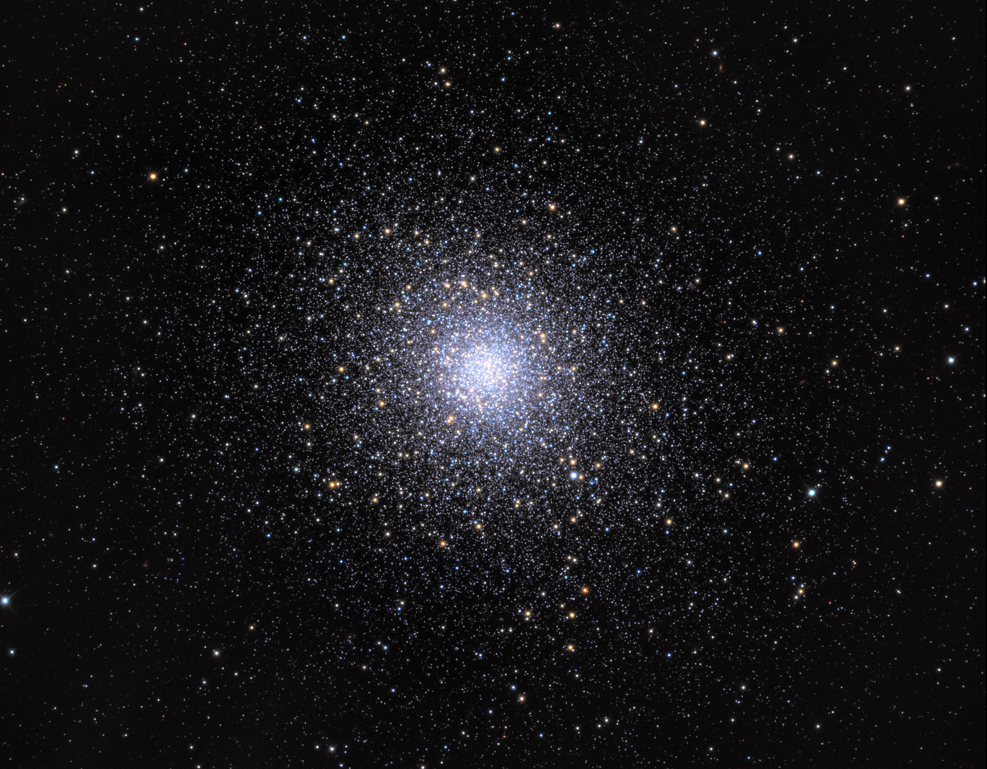
Globular Clusters
Governed by dynamical processes:
Mass segregation
Core collapse
Black hole burning
Ultracompact binaries
Accretion
Credit: Adam Block/Mount Lemmon SkyCenter/University of Arizona
Notes:
Globular Clusters have
million stars
bound together
very dense, 0.4 stars/pc3, increasing to 100-1000stars/pc3 in the core of the cluster.
hundreds to thousands BH form. They all very rapidly mass segregate in few hundred million years, all clusters are thought of to have structure like this.
20% are CC. BH mass-segregate within a Gyr exchanging KE, hardening binaries, energizing the cluster, and other processes, cumulatively known as BH burning. When BH are fully ‘depleted’ is the cluster CC.
Messier 5

Slide 3
Globular Clusters
Governed by dynamical processes:
Mass segregation
Core collapse
Black hole burning
Ultracompact binaries
Accretion
Credit: Adam Block/Mount Lemmon SkyCenter/University of Arizona
Notes:
Globular Clusters have
million stars
bound together
very dense, 0.4 stars/pc3, increasing to 100-1000stars/pc3 in the core of the cluster.
hundreds to thousands BH form.
20% are CC. BH mass-segregate within a Gyr exchanging KE, hardening binaries, energizing the cluster, and other processes, cumulatively known as BH burning. When BH are fully ejected is the cluster CC (20% observed from luminosities).
Messier 5

Slide 4
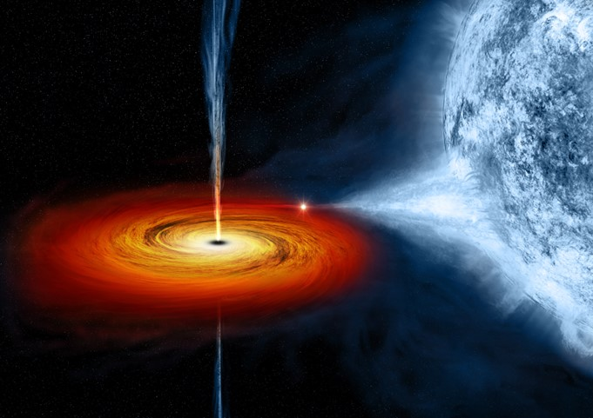
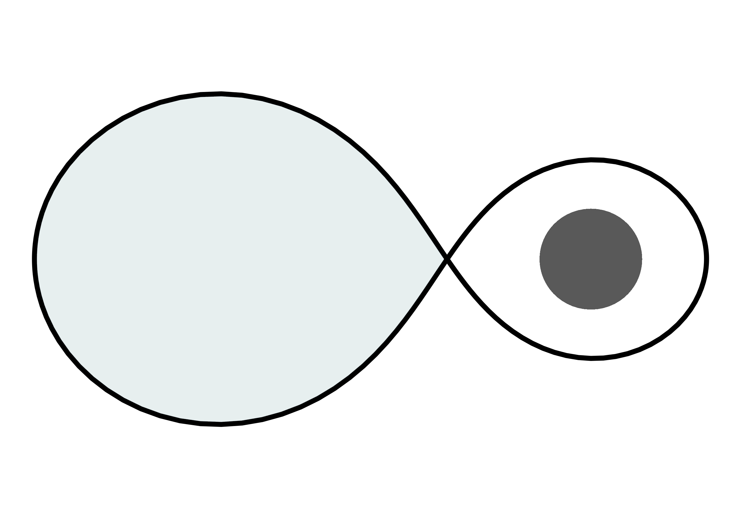
X-ray Binaries
White Dwarf + Black Hole
Dynamically assembled in multi-body interactions.
Credit: NASA/CXC/M. Weiss
Notes:
BH burning: Binary burning. Binary becomes harder, 3rd star gains energy.
Hard binaries form in 3-body interactions.
Once in a hard binary, unlikely to be destroyed. WD inspirals until RLO. Depletes in around 0.1 Gyr.
RLO results in hot accretion disk, generates x-rays.

Slide 5
X-ray Binaries
Giant + Black Hole
Most common formation channel by an order of more than 100x.
Ultracompact binaries
Accretion
Credit: NASA/CXC/M. Weiss
Notes:
Giant/subgiant BH collision also form WDBH binary. Giant core behaves as WD, studies show outer envelope is ejected, can form binary.

Slide 6
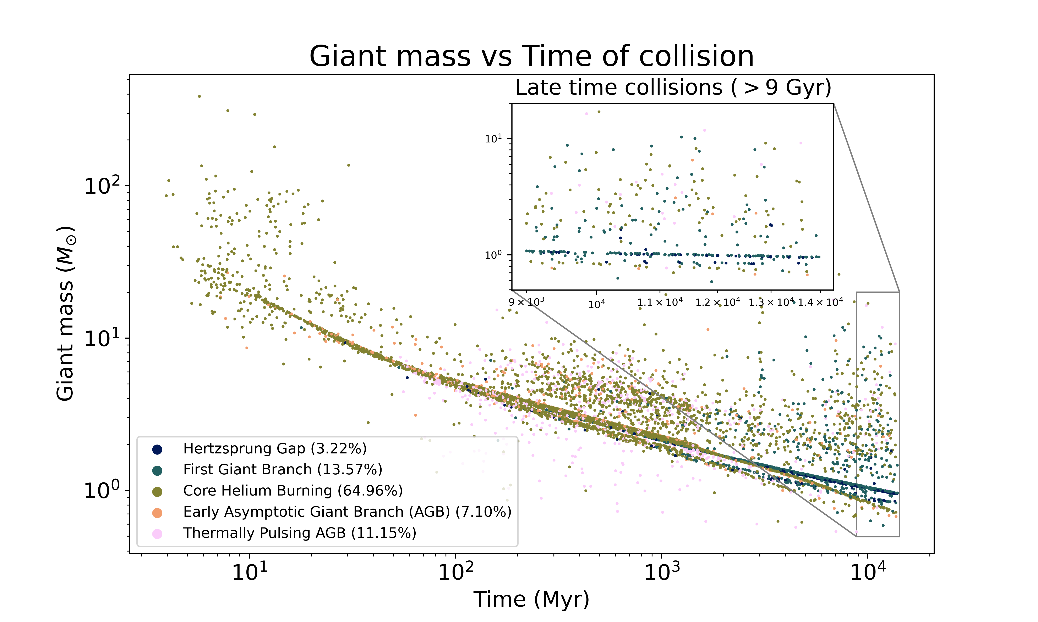
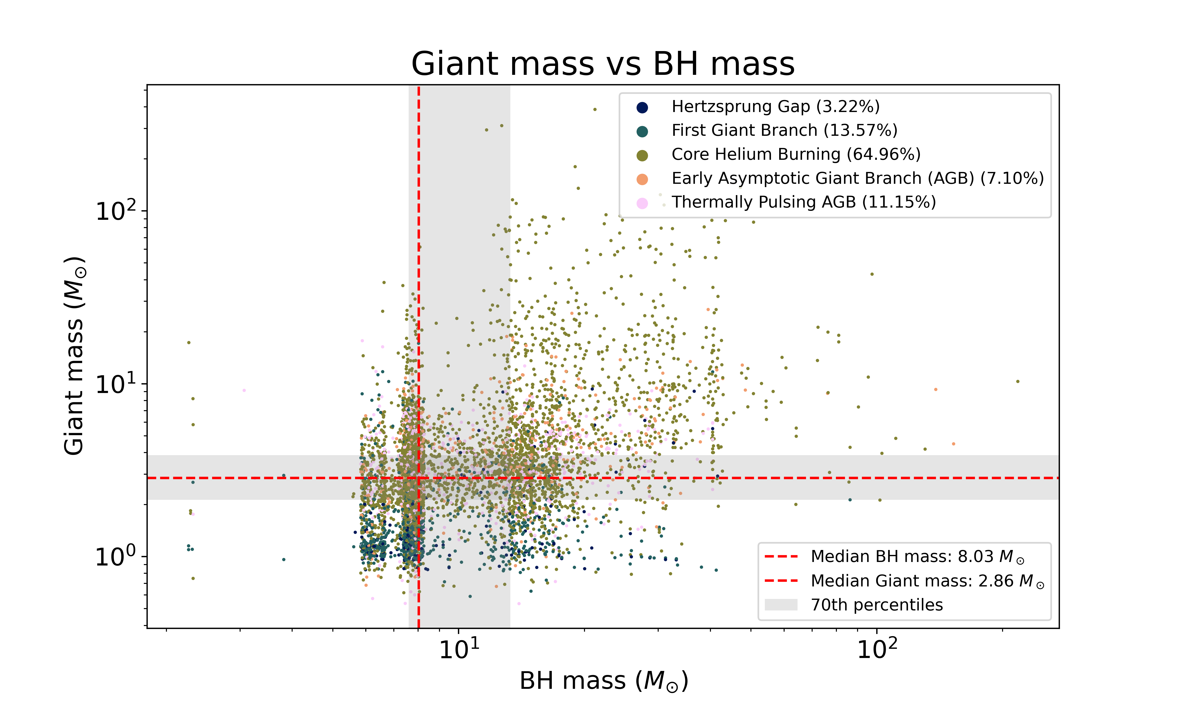
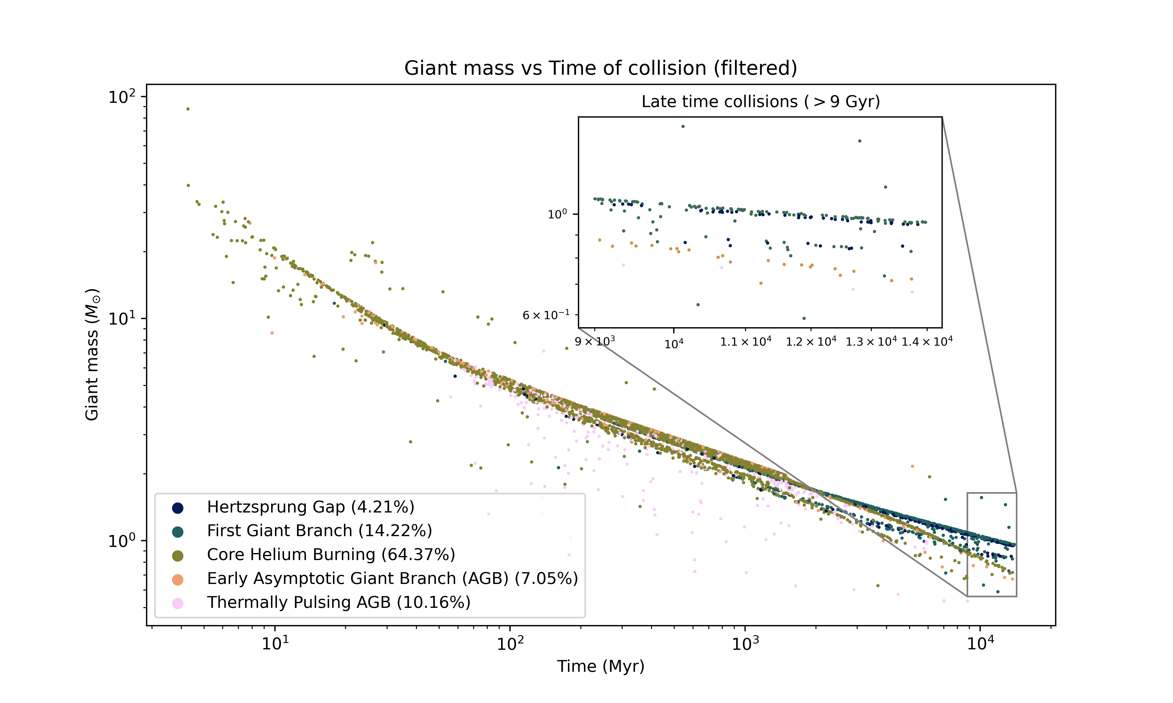
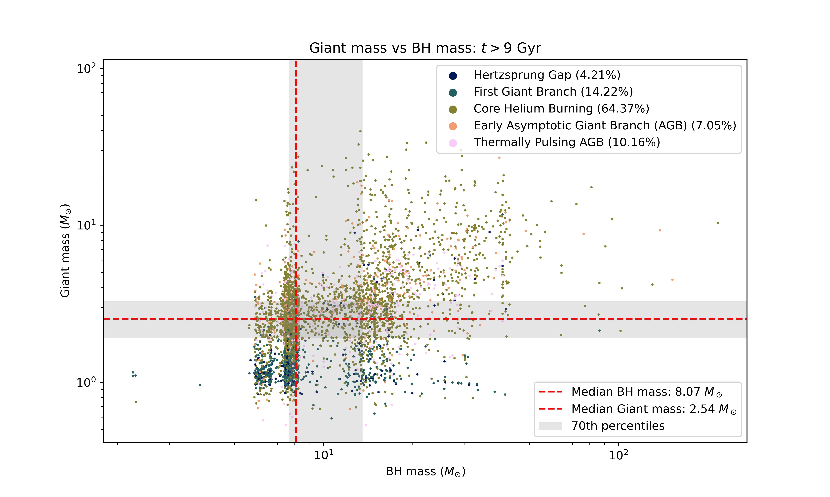
Giant + Black Hole Collisions
Dynamical Interactions
Notes:
There were around 7000 events initially. We can remove giants that are merger products, leaving 4754 events. Restricting to old events, we are left with 206 events out of 387 old events. This will impact our signal predictions by a factor of around 2, which is not significant in our scheme.

Slide 7
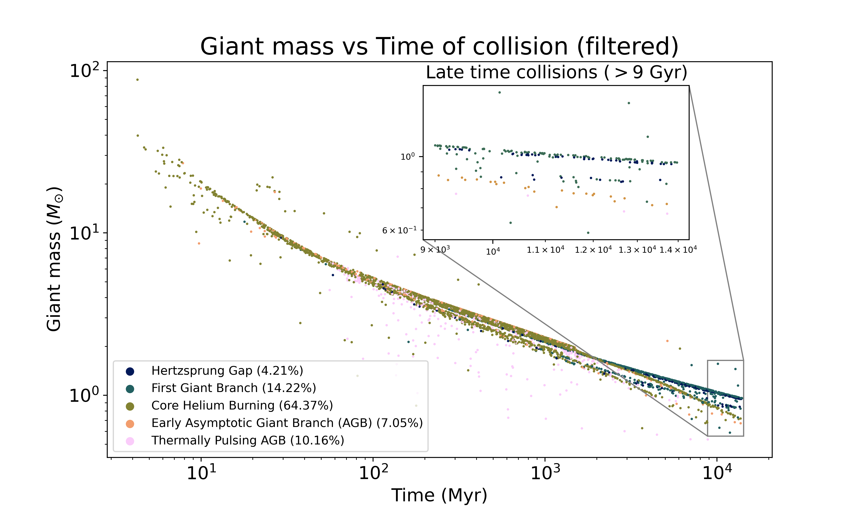
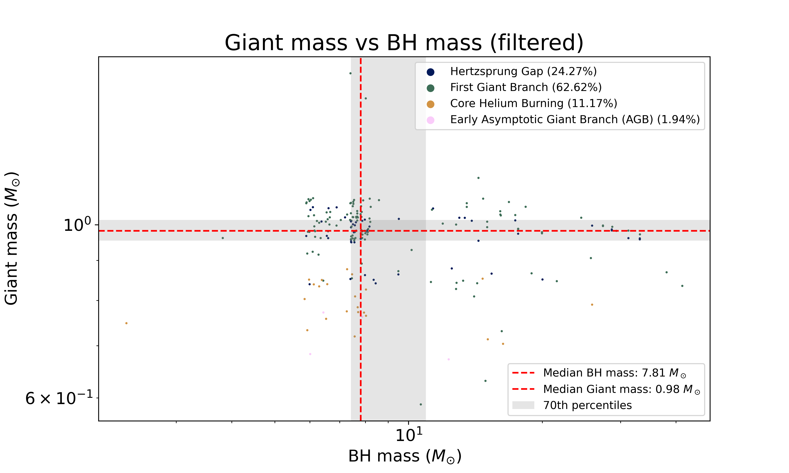
Giant + Black Hole Collisions
Dynamical Interactions without merger products
Notes:
There were around 7000 events initially. We can remove giants that are merger products, leaving 4754 events. Restricting to old events, we are left with 206 events out of 387 old events. This will impact our signal predictions by a factor of around 2, which is not significant in our scheme.

Slide 8
Next Steps
Hydrodynamics simulations of Giant + Black hole collisions.
Estimate gravitational wave inspiral time.
Predict X-ray luminosities of White dwarf + Black hole binary.
Compare models to observations.

Slide 10
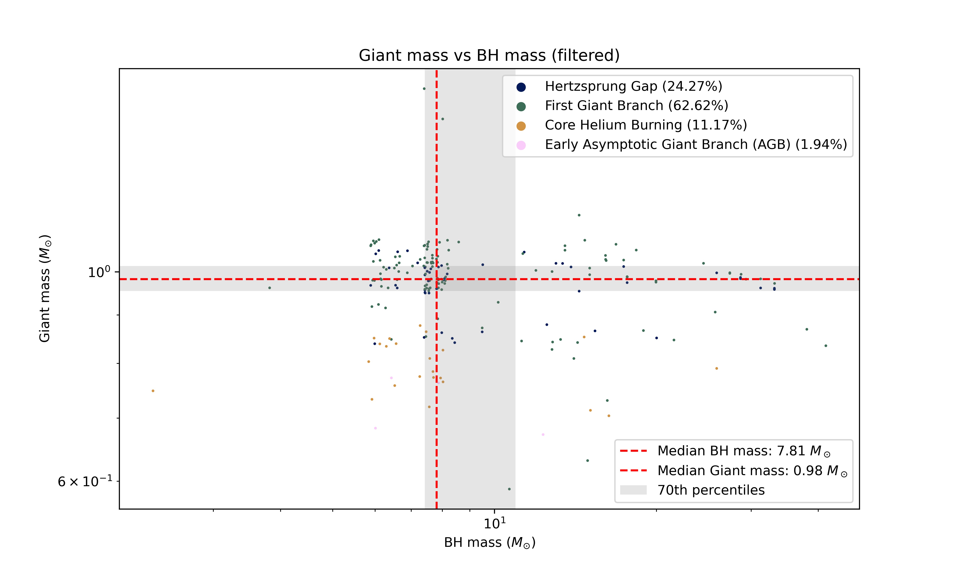
Giant Black Hole Collisions
Dynamical Interactions without merger products
Figure 8. Giant mass vs time of dynamical collision with a black hole filtered to remove giants which are merger products.
Figure 9. Giant mass vs black hole mass filtered to remove giants which are merger products.
Notes:
Giant composition distributions are left largely unchanged

Slide 11
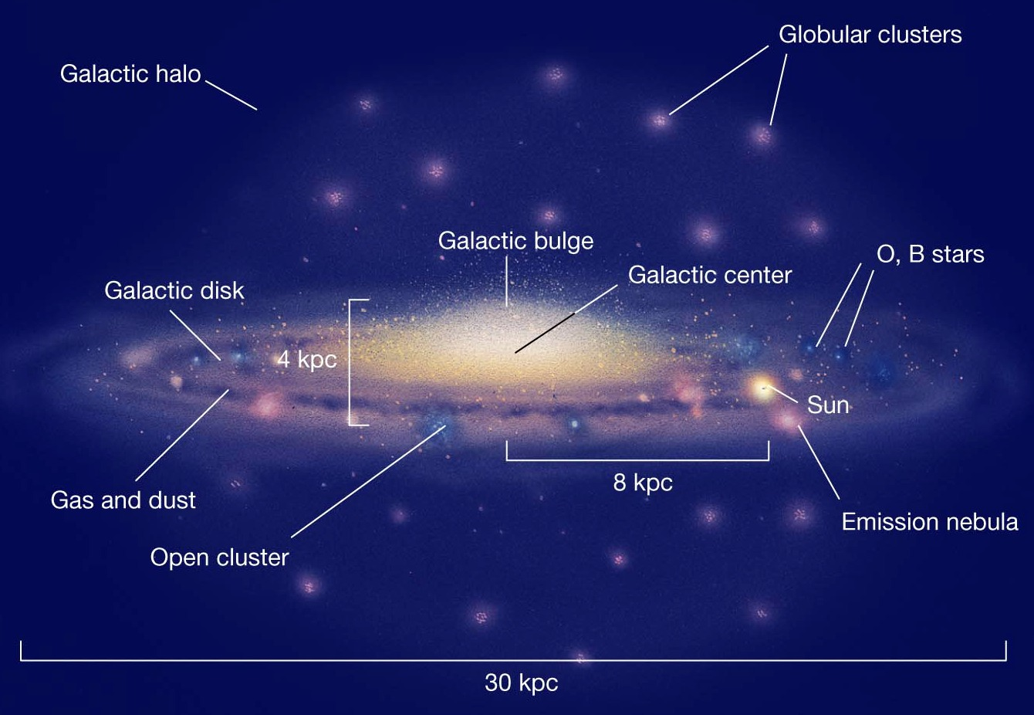
Presence in the Milky Way
387 total late time systems (>9 Gyr) over 145 models.
Estimate around 0.53 Gyr ⁻¹.
MW ~150 GCs; WD depletes in 0.1 Gyr.
Produces ~7 total MW GCs.
Reasonable and agrees with analytic estimates and observation.

Slide 12
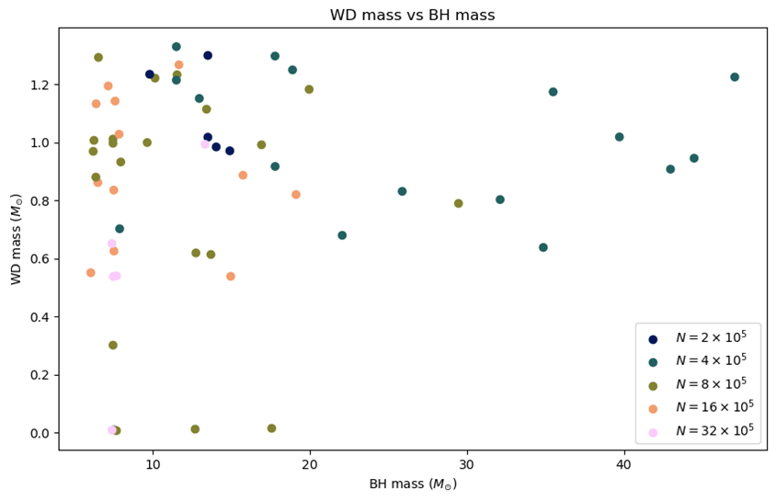
White Dwarf Black Hole Collisions
Dynamical Interactions
Roche Lobe Overflow
5 systems
Figure 5. White dwarf mass against black hole mass with a colour map indicating the initial number of stars within the simulation.

Slide 13
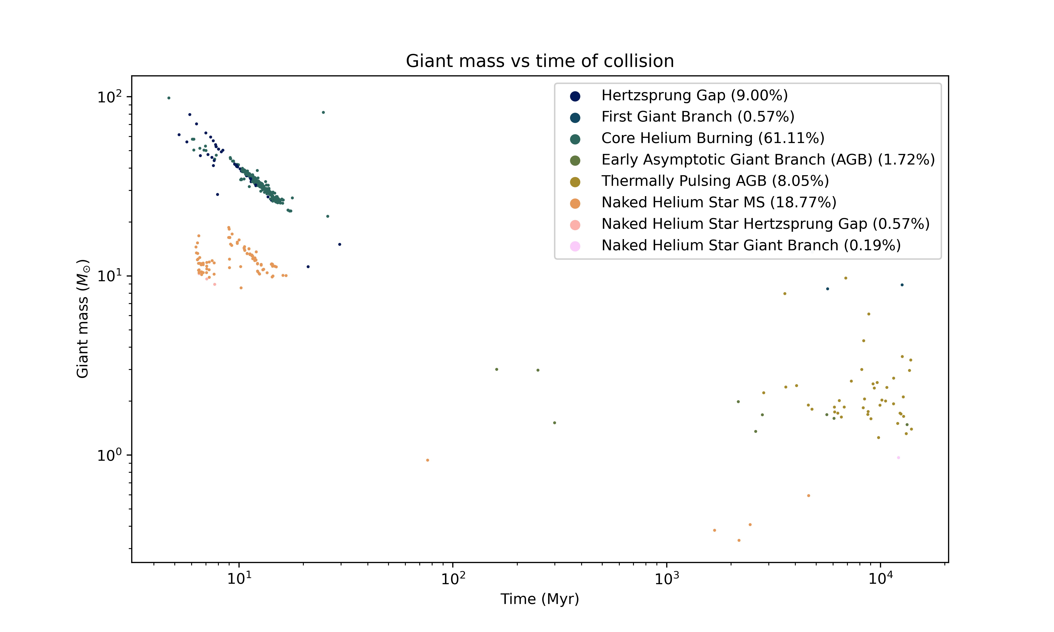
Giant Black Hole Collisions
Unstable Mass Transfer
Found 522 events in total (Figure 10)
Filtering to only keep events that occurred later than 9 Gyr, we are left with 24 events.
Filtering to keep events which weren’t the result of mergers, we are left with 5 events.
Figure 10. Giant mass vs time of inspiral collision with a white dwarf filtered to remove giants which are merger products.

Slide 14
Stellar Evolution with COSMIC
Put a stellar history plot

Slide 15

Modeling Ultracompact Black Hole White Dwarf Binaries in Dense Stellar Clusters
Yi Wei (William) Yang
Mentor: Kyle Kremer
24 July 2024

Slide 16
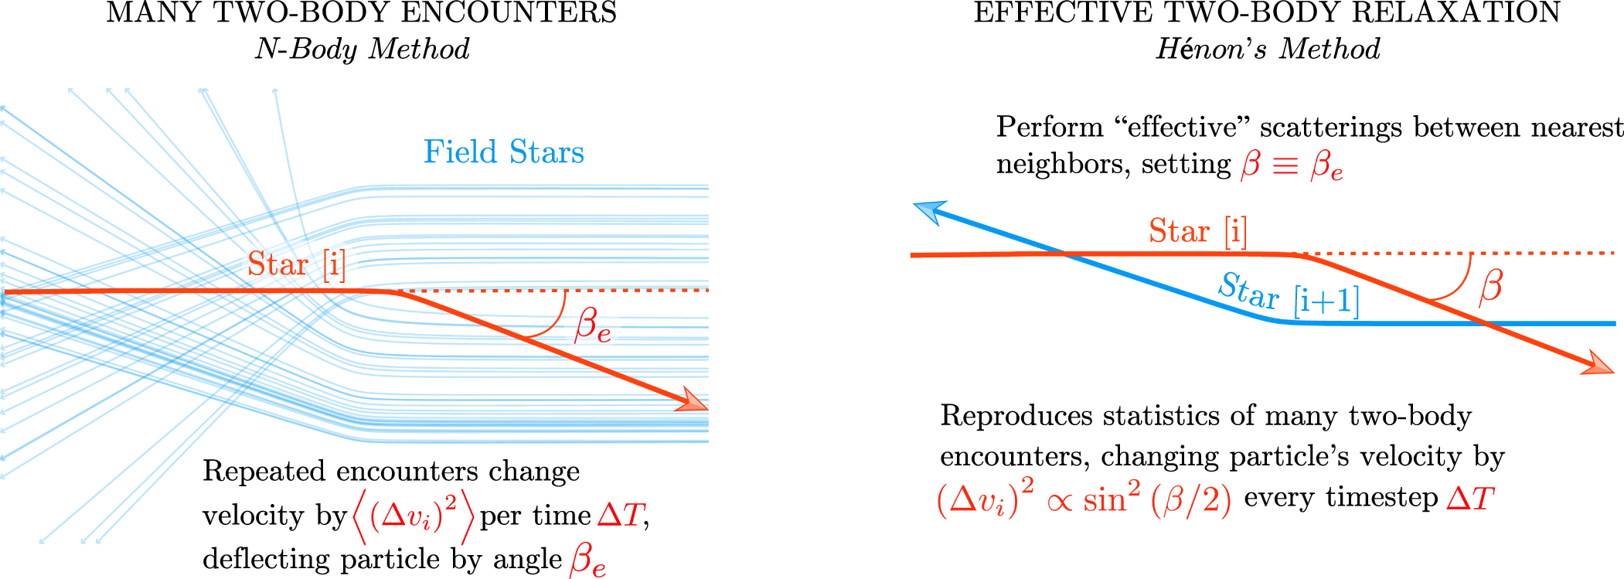
CMC Code Simulations
Figure 1. (top) Traditional direct sum N-body method. Credit: Rodriguez et al. (2022)
Hénon-type Monte Carlo code
Model Initial Parameters:
Virial radius
Galactocentric Distance
Metallicity
Number of stars
Model Outputs:
Regular snapshots
All dynamic interactions
Notes:
CMC uses a Monte Carlo method originally developed by Hénon (1971a, 1971b). Instead of integrating the orbits of each star directly, the Monte Carlo method leverages a statistical treatment of stellar dynamics, where the cumulative effect of many distant two-body encounters is modeled as a single effective scattering between neighboring particles. Collisions are modelled as nearest-neighbour encounters between stars and binaries, allowing for the understanding of the formation of postcollapse evolution of clusters and their production of stellar exotica such as X-ray binaries.
The orbit-averaged Monte Carlo method, originally developed by Hénon (1971a, 1971b), is one such approach. Instead of integrating the orbits of each star directly, the Monte Carlo method leverages a statistical treatment of stellar dynamics, where the cumulative effect of many distant two-body encounters is modeled as a single effective scattering between neighboring particles. The deflection angle of this effective encounter is chosen to reproduce the mean of the averaged change in the velocity per unit time, v 2 á( ) D ñ , experienced by a particle traveling through a field of stars with known density (e.g., Spitzer 1987, Chapter 2). In doing so, Hénon’s method naturally resolves the two-body relaxation that drives the long-term evolution of collisional star systems and has been shown to reproduce the pre- and postcore-collapse evolution of DSCs for nearly 50 yr (Aarseth et al. 1974; Joshi et al. 2000; Giersz et al. 2013; Rodriguez et al. 2016b; Kremer et al. 2020c). Furthermore, by modeling collisional dynamics as nearest-neighbor encounters between radially sorted particles, the Monte Carlo method can also be expanded to include close encounters between stars and binaries, a critical component to understanding the postcollapse evolution of clusters and their production of stellar exotica such as X-ray binaries (Clark 1975; Pooley et al. 2003; Kremer et al. 2018a), millisecond pulsars (Rappaport & Putney 1989; Ye et al. 2019), cataclysmic variables (Grindlay et al. 1995; Kremer et al. 2021), and binary black hole (BBH) mergers (Portegies Zwart & Mcmillan 2000; Rodriguez et al. 2015).

Slide 17
CMC Code Simulations
Figure 1. (top) Traditional direct sum N-body method. Credit: Rodriguez et al. (2022)
Figure 2. (bottom) Schematic diagram of Hénon’s method. Credit: Rodriguez et al. (2022)
Hénon-type Monte Carlo code
Model Initial Parameters:
Virial radius
Galactocentric Distance
Metallicity
Number of stars
Model Outputs:
Regular snapshots
All dynamic interactions
Notes:
CMC uses a Monte Carlo method originally developed by Hénon (1971a, 1971b). Instead of integrating the orbits of each star directly, the Monte Carlo method leverages a statistical treatment of stellar dynamics, where the cumulative effect of many distant two-body encounters is modeled as a single effective scattering between neighboring particles. Collisions are modelled as nearest-neighbour encounters between stars and binaries, allowing for the understanding of the formation of postcollapse evolution of clusters and their production of stellar exotica such as X-ray binaries.
The orbit-averaged Monte Carlo method, originally developed by Hénon (1971a, 1971b), is one such approach. Instead of integrating the orbits of each star directly, the Monte Carlo method leverages a statistical treatment of stellar dynamics, where the cumulative effect of many distant two-body encounters is modeled as a single effective scattering between neighboring particles. The deflection angle of this effective encounter is chosen to reproduce the mean of the averaged change in the velocity per unit time, v 2 á( ) D ñ , experienced by a particle traveling through a field of stars with known density (e.g., Spitzer 1987, Chapter 2). In doing so, Hénon’s method naturally resolves the two-body relaxation that drives the long-term evolution of collisional star systems and has been shown to reproduce the pre- and postcore-collapse evolution of DSCs for nearly 50 yr (Aarseth et al. 1974; Joshi et al. 2000; Giersz et al. 2013; Rodriguez et al. 2016b; Kremer et al. 2020c). Furthermore, by modeling collisional dynamics as nearest-neighbor encounters between radially sorted particles, the Monte Carlo method can also be expanded to include close encounters between stars and binaries, a critical component to understanding the postcollapse evolution of clusters and their production of stellar exotica such as X-ray binaries (Clark 1975; Pooley et al. 2003; Kremer et al. 2018a), millisecond pulsars (Rappaport & Putney 1989; Ye et al. 2019), cataclysmic variables (Grindlay et al. 1995; Kremer et al. 2021), and binary black hole (BBH) mergers (Portegies Zwart & Mcmillan 2000; Rodriguez et al. 2015).

